Slide 1


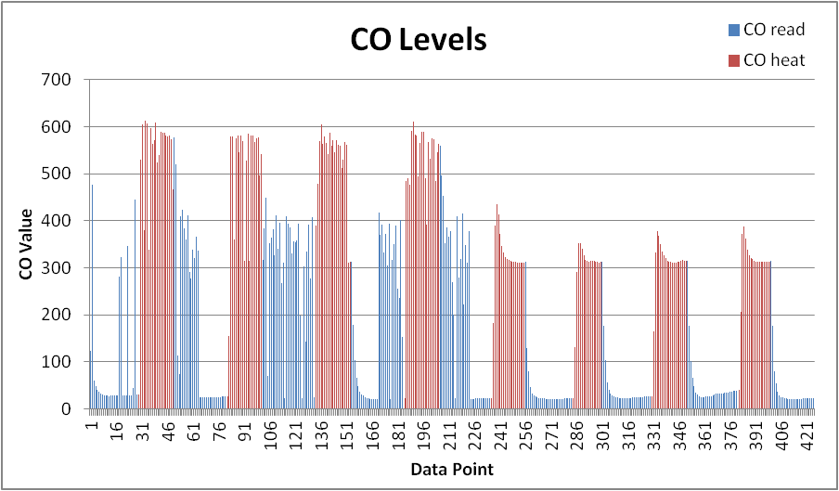
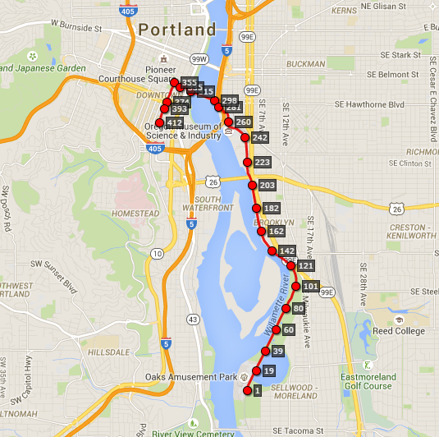
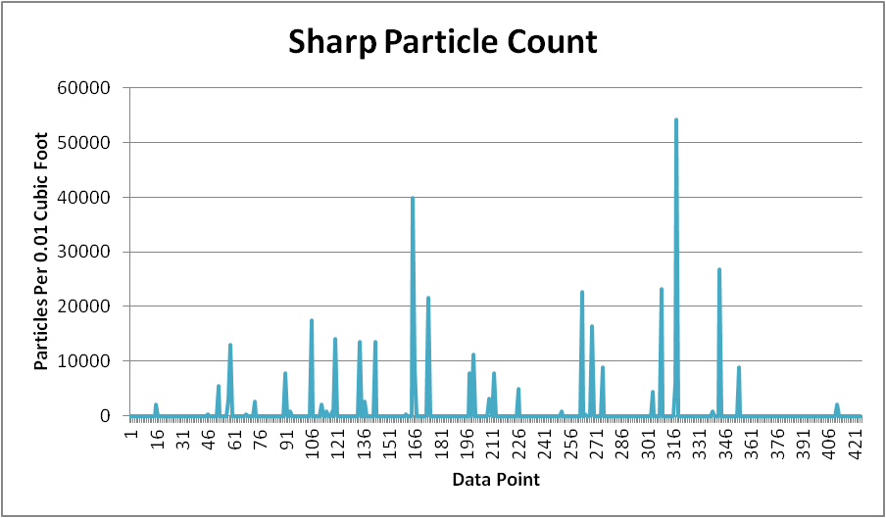
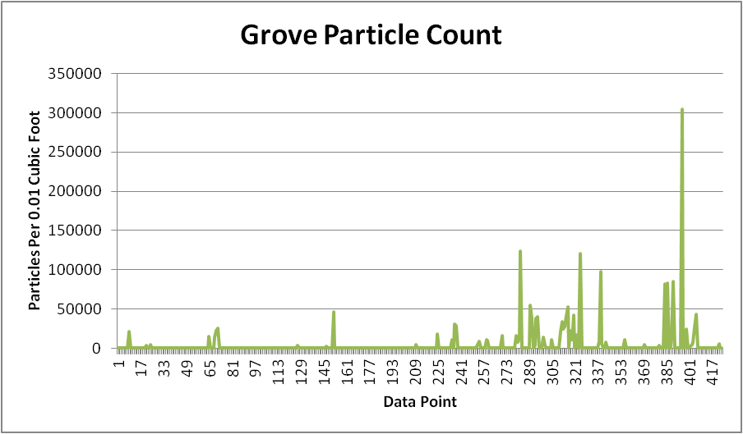
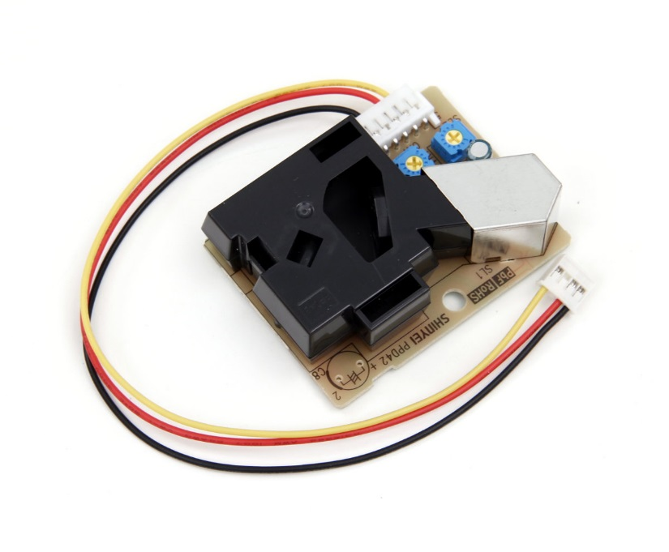
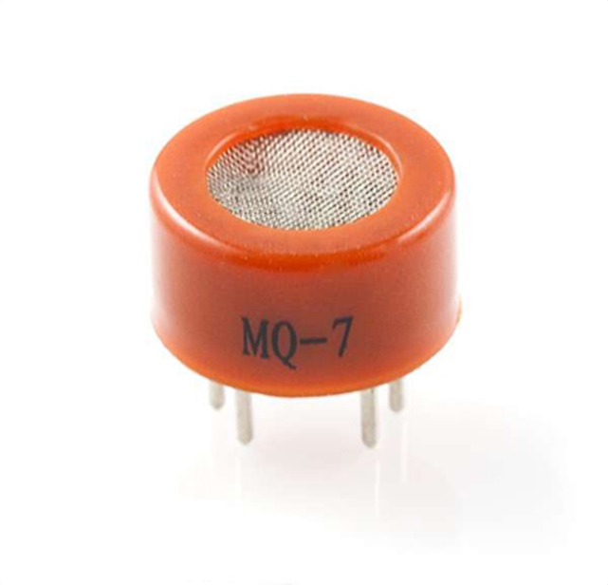
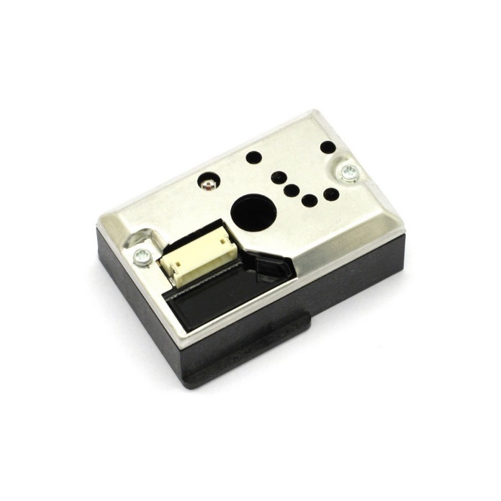
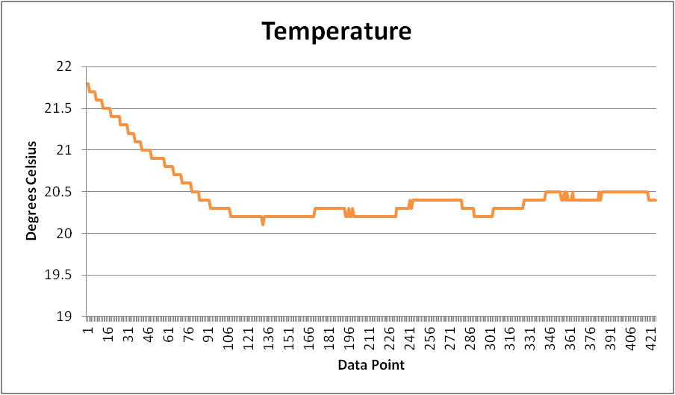
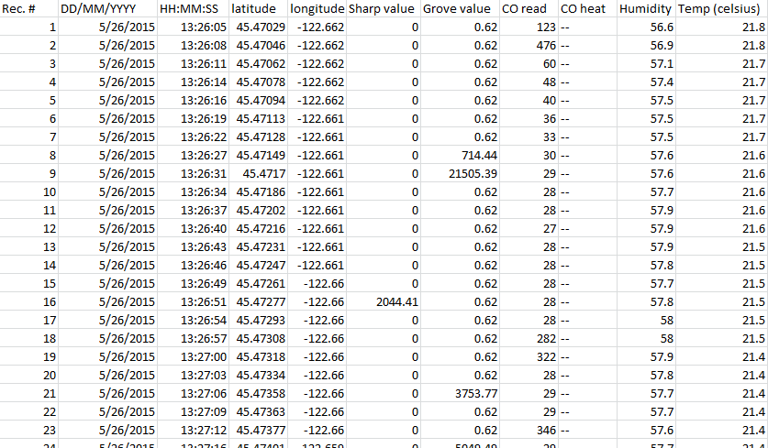
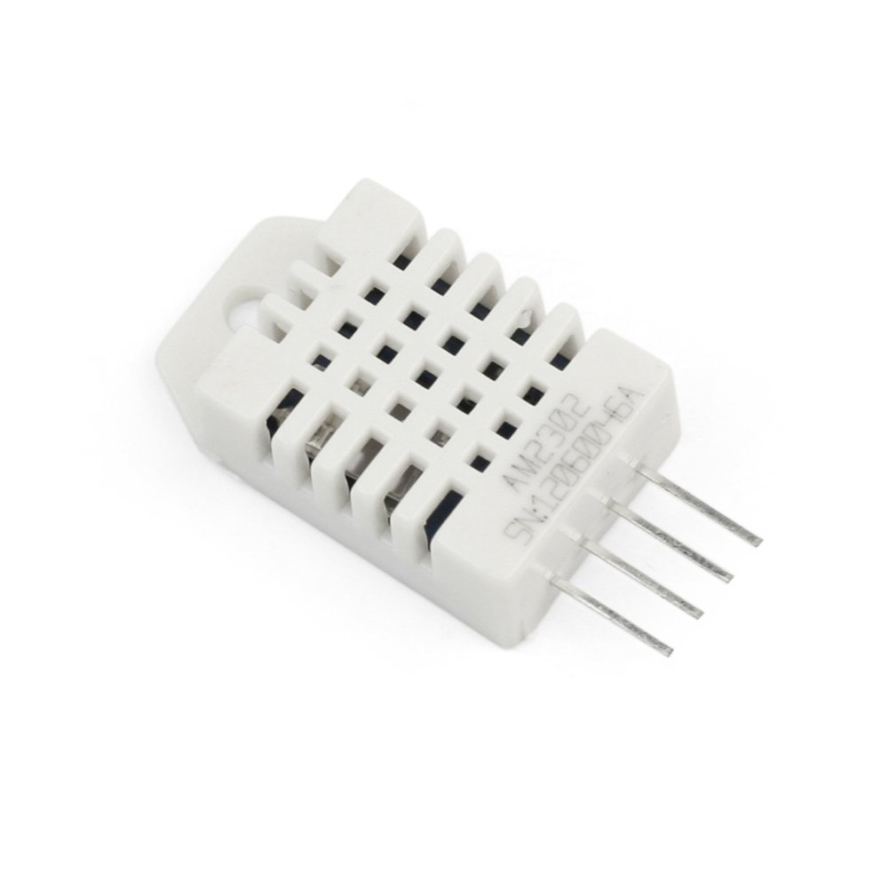
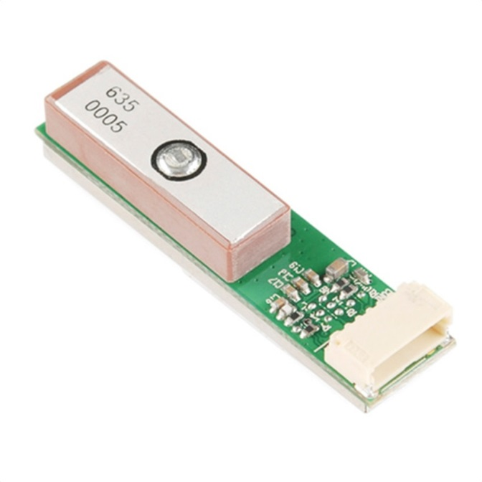
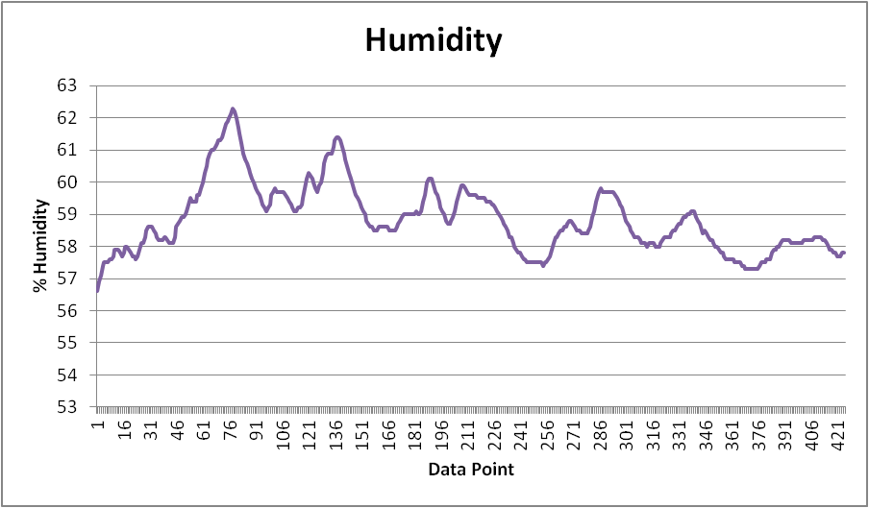
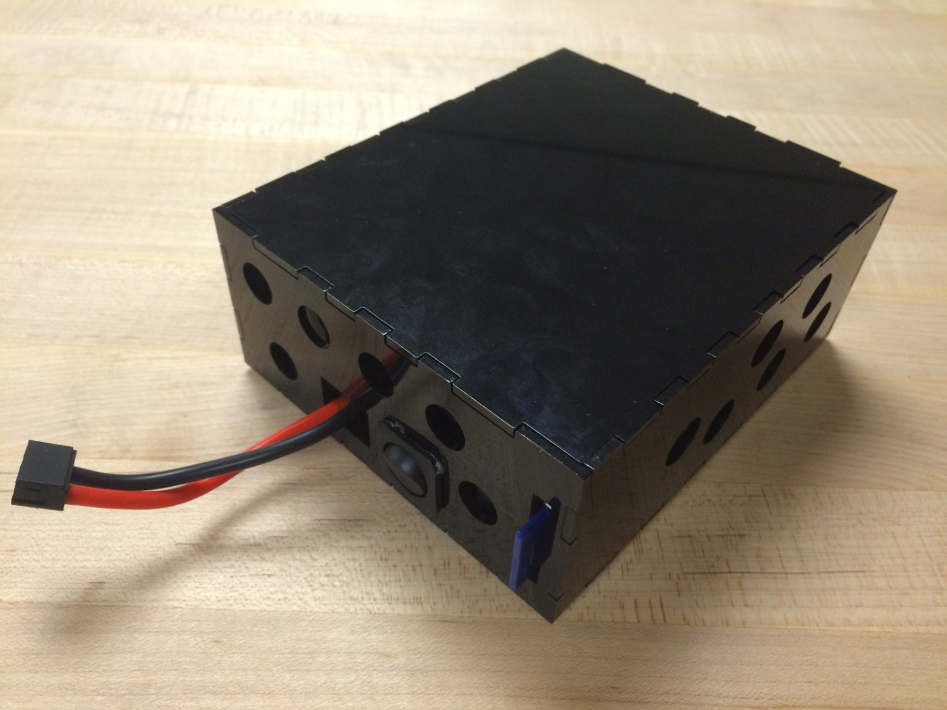
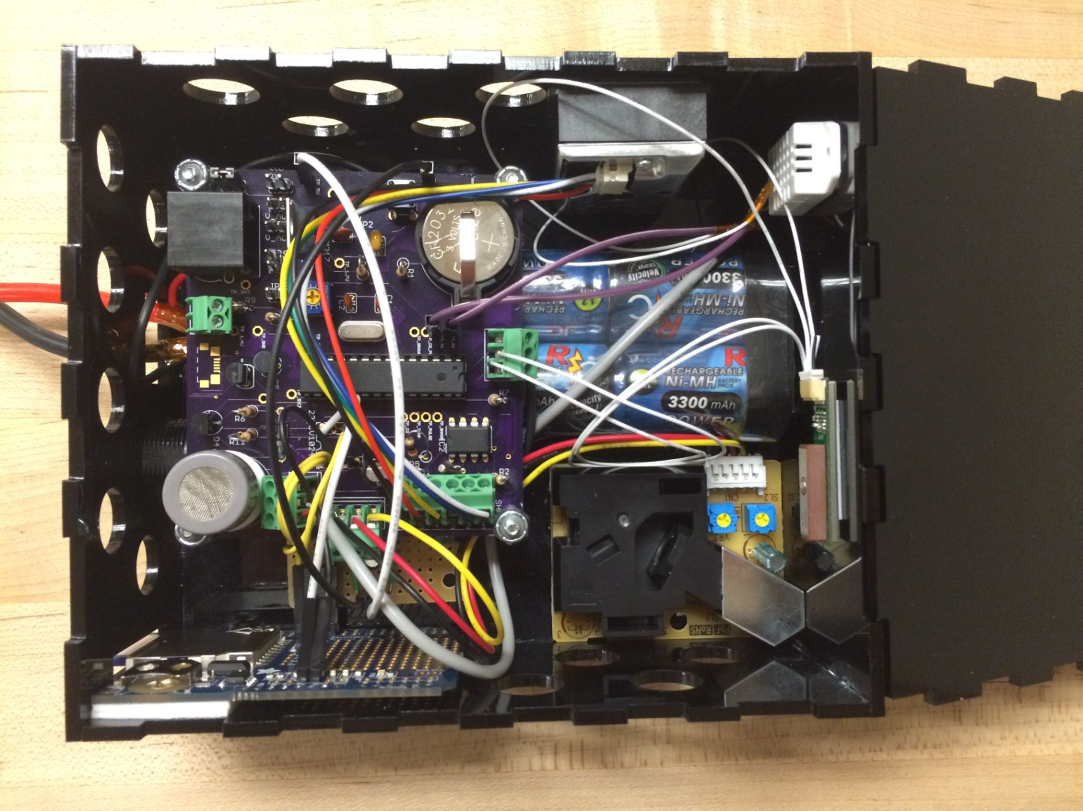

OBI: Air Quality Sensor Hub
Members: Ali Alavi, Robert Flory, Meng Lei, Pedro Munoz Sponsored By: Open Bike Initiative (OBI) & Intel Corp. Advisor: Professor Malgorzata Chrzanowska-Jeske
Introduction
The Open Bike Initiative (OBI) is a bike sharing model based on open hardware and open source software launched in 2013.
The Air Quality Sensor Hub is a self-contained and cost effective unit to be implemented on select OBI bicycles. It is capable of measuring a riders’ exposure to air pollution by collecting real-time air quality information along the traveled paths. By combining the data, commuters can evaluate the best times to travel and ideal paths to take in order to minimize their exposure to pollutants.
System Design
The Arduino based system uses an Atmega 328 microcontroller.
The rechargeable 7.2V Ni-MH battery pack is connected to a 5V linear regulator through a switch. The regulated 5V line powers all the components
of the system including all sensors and can supply approximately 9 hours of power before needing to be charged.
Approximately 90 seconds after power on, the GP-635T GPS begins sending the location, date, and time to the microcontroller.
The DHT22 sensor begins sending the temperature and humidity values to the microcontroller as soon as the system is powered on.
The MQ-7 cycles through a 60 second burn off (cleaning) phase after which it begins reporting relative CO levels to the microcontroller for 90 seconds. The cycle repeats continuously.
The Grove sensor reports the relative concentrations of larger PM particles while the Sharp sensor reports the relative concentrations of smaller PM particles in the air.
The Real-Time Clock (RTC) is set using the time reported by the GPS and is used to track the time for each record.
Every 2 seconds the microcontroller records a new line of sensor data onto a text file saved on the SD memory card.
Sample Data
Pollution
Pollutants as defined by the EPA are:
• Ozone • Nitrous Oxides • Sulfur Dioxide • Lead
• Particulate Matter • Carbon Monoxide
Sensors for Ozone, Nitrous Oxides, Sulfur Dioxide, and Lead are very expensive. In order to keep the system cost effective CO and Particulate Matter (PM) are the main focus.
Grove (Large PM)
MQ-7 (CO)
Sharp (Small PM)
Future Plans
Future models of the OBI systems are expected to have an improved “Smart Lock” capable of wireless, cellular, and RS232 communication via RJ45.
In anticipation of the upgrades, our system is designed with its own RJ45 connector in order to:
Receive commands
Send data for cloud storage and analysis
Transmit power from a dynamo hub
DHT22 (Temp + Humidity)
GP-635T (GPS)
Conclusion
The system was able to successfully meet the following necessary requirements:
Cost Effective
Portable
Self Contained
Measure relative pollutant levels
Correlate data to GPS location
Evaluate environmental factors
Able to adjust to future OBI models
In the future, improvements could be made to reduce the size, improve efficiency, and expand on types of detectable pollutants.
Location, Date, and Time
GP-635T
Battery
Temperature
DHT22
5V Regulator
Humidity
SD
Memory
CO
MQ-7
CO Cycle Switch
Large PM
Grove
Atmega-
328
Micro-controller
RTC
Small PM
Sharp

